Slide 1

Cloud Native Applications
Advancing Spring Boot with Actuator

Slide 2
Spring Boot Actuator 2
Additional Features to help you monitor and manage your application in production
<dependency>
<groupId>org.springframework.boot</groupId>
<artifactId>spring-boot-starter-actuator</artifactId>
</dependency>
Notes:
<number>

Slide 3
How to enable endpoints
Default exposed endpoints are /info and /health.
management.endpoints.web.exposure.include=*
management.endpoints.web.exposure.include=info,health,env
All endpoints are not secured by default.

Slide 4
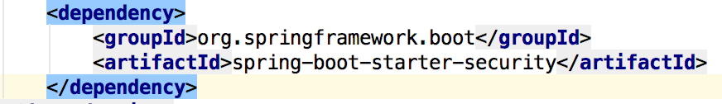
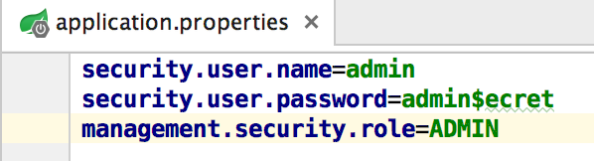
HTTP Access
Importing Spring Security Dependency
Setting required Authentication & Authorization Roles
Notes:
The management endpoints are secure even if the application endpoints are insecure.
Security events are transformed into AuditEvents and published to the AuditService.
The default user will have the ADMIN role as well as the USER role.
<number>

Slide 5

Lab

